Slide 1
Roadmapp
Team: Sharony Braam & Daan Brocatus

Slide 2

Case
Business owner Simon
Business

Slide 3
Concept
Roadmap: a set of tutorials/educational resources in order to acquire more knowledge about a skillset.
Unique roadmap
Track your progress
Earn achievements
Export roadmap to Google Calendar

Slide 4
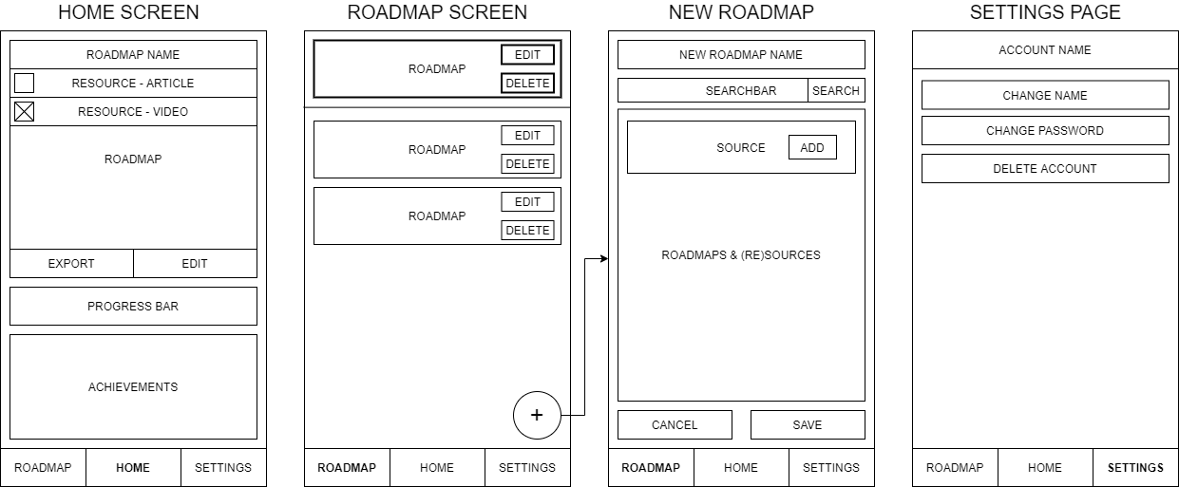
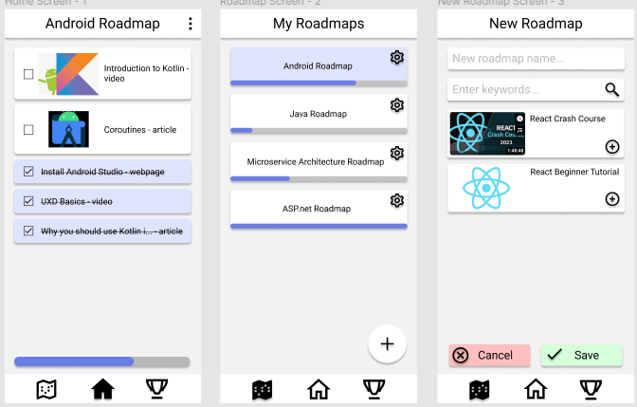
Week 1

Slide 5
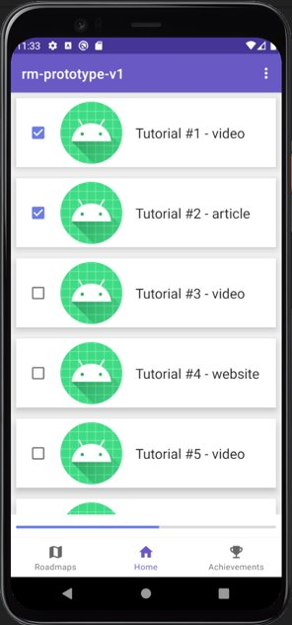
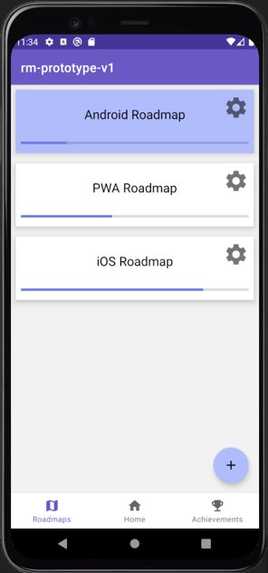
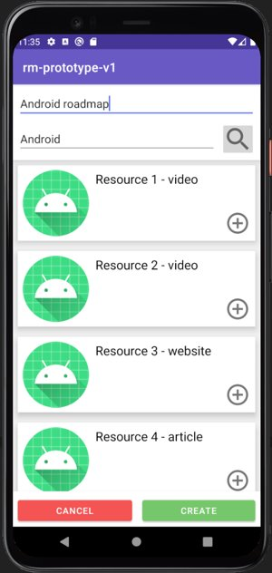
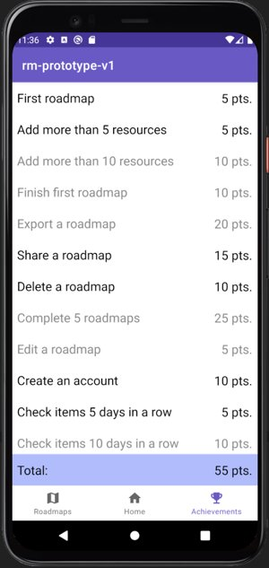
Week 2

Slide 6
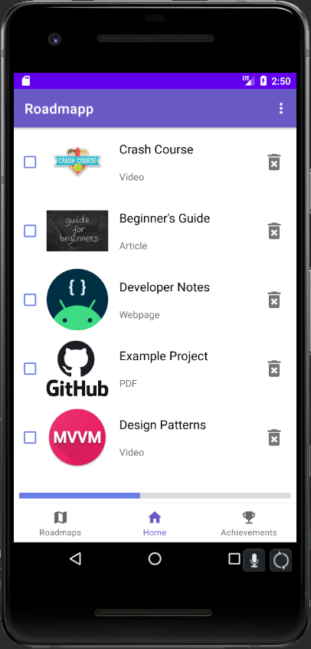
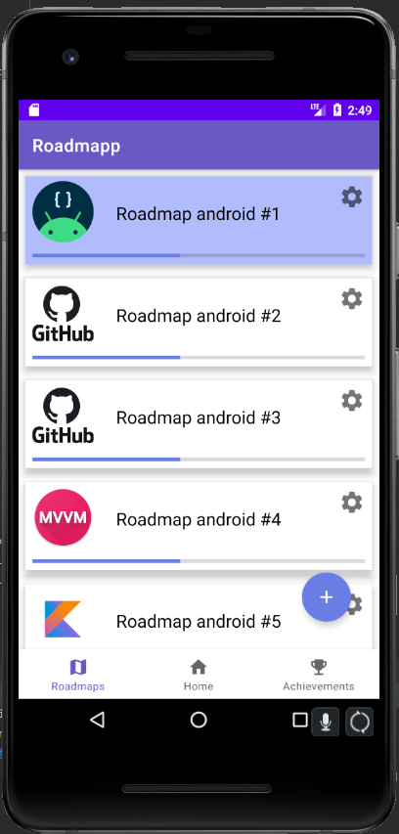
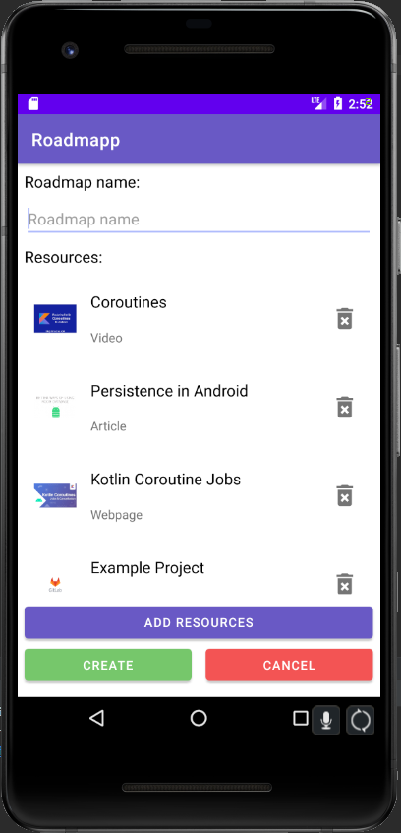
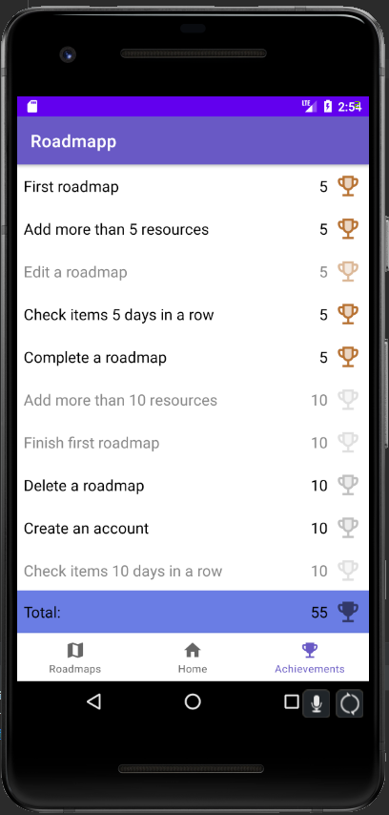
Week 3

Slide 7
Demo

